Slide 1
Gerrit
Workflow and concepts

Slide 2
Agenda
What’s Gerrit?
What’s Code Review?
Gerrit Concepts
Pushing for code review
Pushing new patch sets
Standard Workflow

Slide 3

Gerrit
Code Review:
Gerrit allows to review commits before they are integrated into a target branch.
Code review is optional, but required by default (bypassing code review can be allowed by granting access rights for direct push)
Access Rights:
Gerrit provides fine-grained read and write permissions on branch level (with Git only you always have access to everything once you can access a repository)
This presentation concentrates on the code review aspect, access controls are not covered.
Gerrit is a Git server that provides
Code Review
Access Control on the Git repositories

Slide 4
NOT Gerrit
Gerrit allows integration with third-party tools that provide additional functionalities (see list on the left).
Gerrit does not provide
Code Browsing
Code Search
Project Wiki
Issue Tracking
Continuous Builds
Code Analyzers
Style Checkers

Slide 5
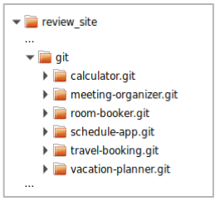
Gerrit
In the Gerrit installation folder on the server (review_site) you can find a git folder that contains all Git repositories that are managed by Gerrit:
these are bare repositories (this means they don’t have a working dir)
the repositories may be hierarchically structured in subfolders
At Google the repositories are not stored in the file system, but in a database.
Gerrit is built on top of Git
it manages standard Git repositories and
controls access and updates to them
Gerrit

Slide 6
Modern Code Review
One developer writes code, another developer is asked to review that code
A careful line-by-line critique
Happens in a non-threatening context
Goal is cooperation, not fault-finding
Integral part of the coding process

Slide 7
Code Review Benefits
Four eyes catch more bugs
Catching bugs early can save hours of debugging later
Mentoring of new developers / contributors
Learn from mistakes without breaking stuff
Establish trust relationships
Prepare for more delegation
Good alternative to pair programming
Asynchronous and across locations
Coding standards
Keep overall readability and code quality high
Even self-reviewing your code in a review tool often let you spot bugs that you wouldn’t have noticed otherwise.

Slide 8
Gerrit Concepts
Gerrit “speaks” the Git protocol ⇒ users only need a Git client (there is no need to install a “Gerrit client”) ⇒ this means Gerrit must somehow map its concepts onto Git
Gerrit allows to review commits before they are integrated into the target branch, but code review is optional
commits are pushed to Gerrit by using the git push command
Git is a toolbox (“Swiss army knife”) which allows many workflows, Gerrit defines one workflow for working with Git
GitHub Pull Requests is another workflow for working with Git (not supported by Gerrit).
Q: Since code review is optional, how does Gerrit know if you push directly to Git or for code review?

Slide 9
Push for Code Review
git push origin HEAD:refs/for/master
From the Git clients perspective it looks like every push for code review goes to the same branch: refs/for/master
However Gerrit tricks the Git client:
it creates a new ref for the commit(s) that are pushed
it creates or updates an open Gerrit change for each pushed commit

Slide 10
Push for Code Review - Case 1
local repository
remote repository
Situation:
The remote repository was cloned, a local featureX branch was created and in this branch a commit C was created.
HEAD
featureX
C
B
origin/master
master
B
A
A
git push origin HEAD:refs/for/master
Q: What happens on push for code review?

Slide 11
Push for Code Review - Case 1
local repository
remote repository
Push for Code Review:
pushes commit C to the remote repository
Gerrit creates a new change ref that points to the new commit (refs/changes/35/135/1)
Gerrit creates a new change object in its database
does not update the master branch in the remote repository (the target branch is only updated once code review was done and the change is approved and submitted)
HEAD
featureX
C
refs/changes/35/135/1
C
B
origin/master
master
B
A
A
git push origin HEAD:refs/for/master

Slide 12
Push for Code Review - Case 2
local repository
remote repository
Situation:
The remote repository was cloned, a local featureX branch was created and in this branch two commits, C and D, were created.
HEAD
featureX
D
C
B
origin/master
master
B
A
A
git push origin HEAD:refs/for/master
Q: Which commits get pushed?

Slide 13
Push for Code Review - Case 2
local repository
remote repository
Push for Code Review:
pushes all commits which are reachable from the pushed commit and which are not available in the remote repository
for each pushed commit Gerrit creates a change ref and a Gerrit change in its database
The change for commit D depends on the change for commit C (since commit D depends on commit C).
HEAD
refs/changes/36/136/1
D
featureX
D
depends on
C
refs/changes/35/135/1
C
B
origin/master
master
B
A
A
git push origin HEAD:refs/for/master

Slide 14
Push for Code Review - Case 3
local repository
remote repository
Situation:
The remote repository was cloned, a local featureX branch was created and in this branch a commit C was created. In the meantime the remote branch master was updated to a commit D.
HEAD
featureX
C
master
D
B
origin/master
B
A
A
git push origin HEAD:refs/for/master
Q: What happens on push for code review?

Slide 15
Push for Code Review - Case 3
local repository
remote repository
The push succeeds:
Gerrit accepts commit C and creates a new change for it.
The push succeeds even if commit C and D would be conflicting.
If the push would have been done directly to Git this push would have failed since master cannot be fast-forwarded to the pushed commit.
Submitting the change may or may not succeed (depends on the submit strategy which is explained later).
HEAD
featureX
C
master
D
C
B
origin/master
B
refs/changes/35/135/1
A
A
git push origin HEAD:refs/for/master

Slide 16
Change
the numeric ID uniquely identifies a change on a Gerrit server
the change owner is the user that uploaded the change (can differ from committer and commit author)
patch sets correspond to Git commits (more about patch sets later)
Change-Id (unique per repository and branch, explained later)
Numeric ID: 135
Metadata: project, target branch, owner, etc
1 or more patch sets
Commit
comments
votes
Change-Id
...

Slide 17
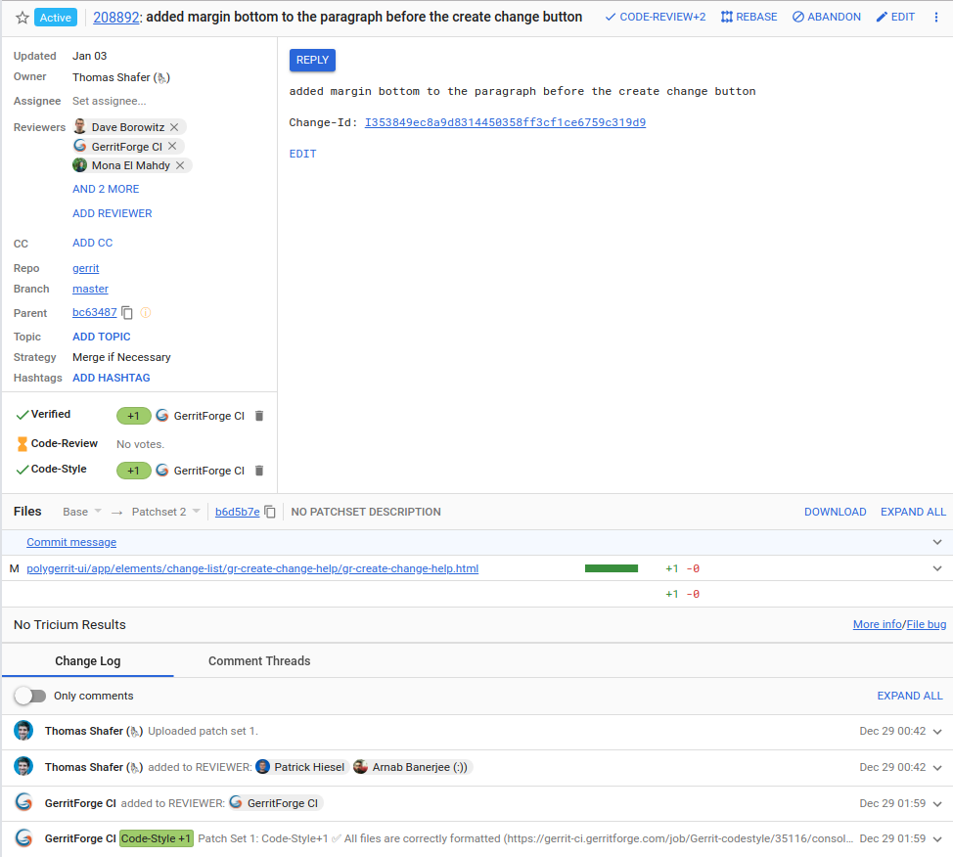
Review and Vote
Changes can be inspected in the Gerrit WebUI:
The change screen shows you all information about a change, including which files have been changed.

Slide 18
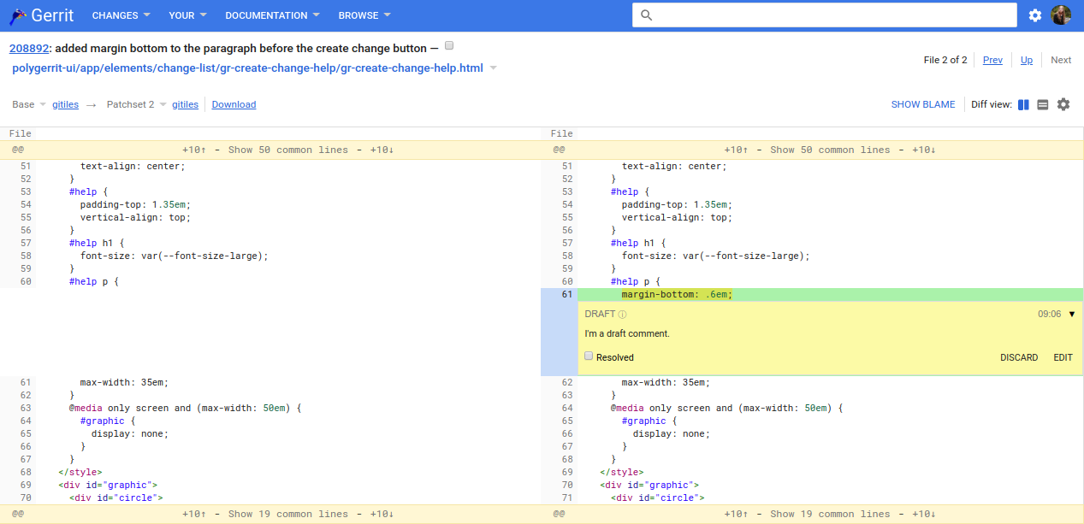
Review and Vote
Changes can be inspected in the Gerrit WebUI.
The change screen shows you all information about a change, including which files have been changed.
For each modified file you can review the file diff and comment inline on it, which creates unpublished draft comments. You can also reply to existing comments.
refs/changes/92/208892/1
C
Compared versions:
left side: commit B (base/parent version)
right side: commit C
master
B
A

Slide 19
Change-Id
Change-Id: ID of a change that is set as footer in the commit message.
Automatically generated and inserted on commit by a commit hook.
If a commit is pushed that contains a Change-Id in the commit message Gerrit checks if a change with this Change-Id already exists.
If yes, this change is updated.
If not, a new change with that Change-Id is created.
The Gerrit commit-msg hook that generates and inserts Change-Ids on git commit must be installed once in a repository after it was cloned:
The clone command that is offered by Gerrit in the WebUI includes the command to install the commit-msg hook.

Slide 20
Change-Id
Change-Id:
Format: ‘I’ + SHA1
To be recognized by Gerrit the Change-Id must be contained in the last paragraph of the commit message (as all Git footers)
First line is the subject, should be shorter than 70 chars
Separate the body from the subject by an empty line. The commit message should describe why you are doing the change. That's what typically helps best to understand what the change is about. The details of what you changed are visible from the file diffs. The body can have as many paragraphs as you want. Lines shouldn't exceed 80 chars. This helps command line tools to render it nicely. Paragraphs are separated by empty lines.
Change-Id: I3eefa6661010058d3684b2983f5b38bf3233d0f7
Bug: Issue 123
Q: What is a patch set?

Slide 21
Change ref
All change refs share the same refs/changes/ namespace. Refs in this namespace are not automatically fetched on git clone and git fetch.
Can be fetched on need. Gerrit offers the fetch command on the change screen so that patch sets can be easily downloaded (e.g. to amend them and create a new patch set).
refs/changes/35/135/1
Ref prefix that is used for all change refs.
The patch set number.
Sharded numeric change ID. The numeric change ID is 135, the last 2 digits are used as prefix for sharding.

Slide 22
Submit
Pre-conditions for submit:
The change has an approval (highest possible vote) for each review label.
None of the review labels has a veto vote (lowest possible vote)
The change doesn’t depend on other changes that are non-submittable.
The user is allowed to submit.
Submit integrates a change into its target branch (more precisely integrates the current patch set into the target branch):
The master branch is fast-forwarded to the commit that represents the current patch set.
-1
refs/changes/32/206232/1
C
D
refs/changes/32/206232/2
+2
master
B
master
A

Slide 23
Submit Type / Submit Strategy
The behaviour on submit is configurable per repository:
Submit Type / Submit Strategy:
FAST_FORWARD_ONLY: Submit fails if fast-forward is not possible.
MERGE_IF_NECESSARY: If fast-forward is not possible, a merge commit is created.
REBASE_IF_NECESSARY: If fast-forward is not possible, the current patch set is automatically rebased (creates a new patch set which is submitted).
MERGE_ALWAYS: A merge commit is always created, even if fast-forward is possible.
REBASE_ALWAYS: The current patch set is always rebased, even if fast-forward is possible. For all rebased commits some additional footers will be added (Reviewed-On, Reviewed-By, Tested-By).
CHERRY_PICK: The change is cherry-picked. This ignores change dependencies. For all cherry-picked commits some additional footers will be added (Reviewed-On, Reviewed-By, Tested-By).
Allow content merges:
whether Gerrit should do a content merge if the same files have been touched
Recommended setting:
Submit type: MERGE_IF_NECESSARY or REBASE_IF_NECESSARY
Allow content merges: true
Safest setting:
FAST_FORWARD_ONLY
With all other submit types there is a possibility that the submitted commit is broken.
Requires users to rebase changes whenever any change is submitted
Only feasible if there is a low frequency of incoming changes.
Notes:
Submit Type and Submit Strategy are used synonymously.

Slide 24
Submit - CHERRY_PICK
Situation:
There is a change series with two changes, the change for commit D depends on the change for commit C.
The change for commit D was approved, the change for commit C got a negative review and needs to be reworked. Hence the change for commit C is not submittable.
D
refs/changes/32/206232/1
+2
C
refs/changes/31/206231/1
-1
master
B
A
Q: What happens on submit of the change for commit D?

Slide 25
Submit - CHERRY_PICK
The change for commit D is submittable since the CHERRY_PICK submit strategy ignores change dependencies (with all other submit strategies the change would be non-submittable because it depends on a non-submittable change).
The current patch set of the submitted change is cherry-picked and the target branch is fast-forwarded to it.
The cherry-pick may fail with conflicts.
Guarantees that all submitted commits have additional footers which are inserted on cherry-pick (e.g. Reviewed-On, Reviewed-By, Tested-By).
D
refs/changes/32/206232/1
+2
master
E
∆D
∆D
C
refs/changes/31/206231/1
-1
∆C
master
B
A

Slide 26
Standard Workflow (Summary)
local repository
remote repository
Situation:
The master branch in the remote repository contains two commits, commit A and commit B. Both commits have been fetched into the local repository.
origin/master
B
master
B
A
A

Slide 27
Standard Workflow (Summary)
local repository
remote repository
Create and checkout a local feature branch which is based on origin/master: git checkout -b featureX origin/master
HEAD
origin/master
B
featureX
master
B
A
A

Slide 28
Standard Workflow (Summary)
local repository
remote repository
Create and checkout a local feature branch which is based on origin/master: git checkout -b featureX origin/master
Make a new commit that implements the feature.
HEAD
C
featureX
origin/master
B
featureX
master
B
A
A

Slide 29
Standard Workflow (Summary)
local repository
remote repository
Create and checkout a local feature branch which is based on origin/master: git checkout -b featureX origin/master
Make a new commit that implements the feature.
Push the commit for code review: git push origin HEAD:refs/for/master
HEAD
C
featureX
C
refs/changes/23/123/1
origin/master
B
master
B
A
A

Slide 30
Standard Workflow (Summary)
local repository
remote repository
Create and checkout a local feature branch which is based on origin/master: git checkout -b featureX origin/master
Make a new commit that implements the feature.
Push the commit for code review: git push origin HEAD:refs/for/master
If rework is needed:
Checkout the featureX branch and amend the commit.
HEAD
featureX
C
D
featureX
C
refs/changes/23/123/1
origin/master
B
master
B
A
A

Slide 31
Standard Workflow (Summary)
local repository
remote repository
Create and checkout a local feature branch which is based on origin/master: git checkout -b featureX origin/master
Make a new commit that implements the feature.
Push the commit for code review: git push origin HEAD:refs/for/master
If rework is needed:
Checkout the featureX branch and amend the commit.
Push the new commit for review to create a second patch set
HEAD
C
D
featureX
C
D
refs/changes/23/123/2
origin/master
B
master
B
refs/changes/23/123/1
A
A

Slide 32
Standard Workflow (Summary)
local repository
remote repository
...
Make a new commit that implements the feature.
Push the commit for code review: git push origin HEAD:refs/for/master
If rework is needed:
Checkout the featureX branch and amend the commit.
Push the new commit for review to create a second patch set
If rebase is needed
HEAD
master
E
C
D
C
D
featureX
master
B
refs/changes/23/123/2
origin/master
B
A
refs/changes/23/123/1
A

Slide 33
Standard Workflow (Summary)
local repository
remote repository
...
Make a new commit that implements the feature.
Push the commit for code review: git push origin HEAD:refs/for/master
If rework is needed:
Checkout the featureX branch and amend the commit.
Push the new commit for review to create a second patch set
If rebase is needed:
Fetch the updates from the remote repository
HEAD
HEAD
E
C
C
D
D
featureX
E
C
D
featureX
master
B
origin/master
B
B
refs/changes/23/123/2
A
origin/master
A
A
refs/changes/23/123/1

Slide 34
Standard Workflow (Summary)
local repository
remote repository
...
Make a new commit that implements the feature.
Push the commit for code review: git push origin HEAD:refs/for/master
If rework is needed:
Checkout the featureX branch and amend the commit.
Push the new commit for review to create a second patch set
If rebase is needed:
Fetch the updates from the remote repository
Checkout the featureX branch and rebase it onto origin/master
HEAD
HEAD
F
featureX
featureX
∆D + conflict resolution
E
C
C
D
D
featureX
master
E
C
D
∆D
B
origin/master
B
B
refs/changes/23/123/2
A
A
A
refs/changes/23/123/1

Slide 35
Standard Workflow (Summary)
local repository
remote repository
...
…
...
If rework is needed:
Checkout the featureX branch and amend the commit.
Push the new commit for review to create a second patch set
If rebase is needed:
Fetch the updates from the remote repository
Checkout the featureX branch and rebase it onto origin/master
Push the new commit for review to create a third patch set
HEAD
HEAD
F
featureX
featureX
F
refs/changes/23/123/3
∆D + conflict resolution
E
C
C
D
D
master
E
C
D
∆D
B
origin/master
B
B
refs/changes/23/123/2
A
A
A
refs/changes/23/123/1

Slide 36
Standard Workflow (Summary)
local repository
remote repository
Note that we didn’t use any local master branch. In fact a master branch in the local repository is not needed when working with Gerrit. It’s recommended to delete the local master branch to avoid any confusion with it.
HEAD
HEAD
F
featureX
featureX
F
refs/changes/23/123/3
∆D + conflict resolution
E
C
C
D
D
master
E
C
D
∆D
B
origin/master
B
B
refs/changes/23/123/2
A
A
A
refs/changes/23/123/1

Slide 37
Repository Configuration
Gerrit stores a configuration per repository.
This configuration contains:
a repository description
the parent repository
the access rights
project options (e.g. submit type, the Allow content merges setting etc.)
the definition of the review labels, including the possible voting values
Gerrit uses the term project as synonym for repository.
Every repository has a special refs/meta/config branch that contains a project.config file with the Gerrit configuration for the repository.
The refs/meta/config branch is completely disconnected from the branches that are used for development (they don’t share any common ancestor commit).
By default only repository owners have access to the refs/meta/config branch.
Many settings in the repository configuration are inheritable. This means settings on a parent repository apply to all child repositories unless they are overwritten in the child repositories. Examples for inheritable settings are: access rights, submit type and review label definitions
master
C
B
2
refs/meta/config
A
1

Slide 38
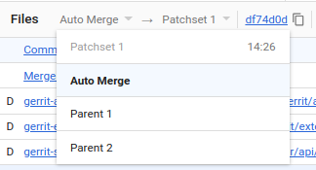
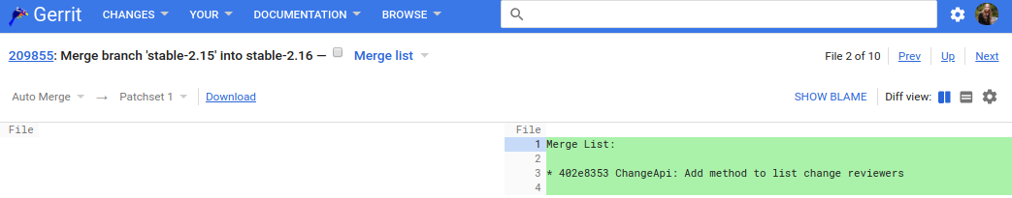
Review Merge Commits
Merge commits that are pushed for code review should have the tip of the target branch as first parent.
By default patch sets of a merge commit are compared against the Auto Merge version, but you can also choose to compare against the first or second parent commit.
The Auto Merge version is the result of automatically merging parent 2 into parent 1. This version may contain Git conflict markers.
The file list of merge commits contains a magic Merge list file. This file contains a generated list of commits that are brought into the target branch by this merge. This information is shown as a file so that reviewers can comment on it.

Slide 39
Change States
When a change is uploaded for code review it is in the In Review state (aka New).
Abandoned means that the change has been given up and nobody is actively working on it.
Abandoned changes can be restored any time.
If a change gets approved and submitted it is in state Merged.
Merged and abandoned changes are closed. This means no new patch sets can be uploaded.
Changes that have not been submitted yet may be deleted, but this should only be done in exceptional cases (e.g. if the change leaks internal information that cannot be removed otherwise)
In Review (New)
submit
Merged
delete
abandon
restore
Abandoned
delete
Deleted
open
closed
Notes:
After deletion of a change the corresponding commits still exist, but they are no longer accessible and will be removed on the next garbage collection run.

Slide 40
Private Changes
Changes can be marked as private.
Private changes are only visible to the change owner and reviewers of the change.
Use cases:
Backup unfinished work.
Collaborate with some reviewers on an experimental change in private.
Changes can be marked as private on push: git push origin HEAD:refs/for/master -o private
On the change screen the private flag can be toggled to make the change visible to other users.
The global View Private Changes capability can grant users the permission to view all private changes.

